Slide 1
BCOG 100
Memory, Simulation, & Generative Models
Lecture 2: Algorithms for Memory and Simulation

Slide 2
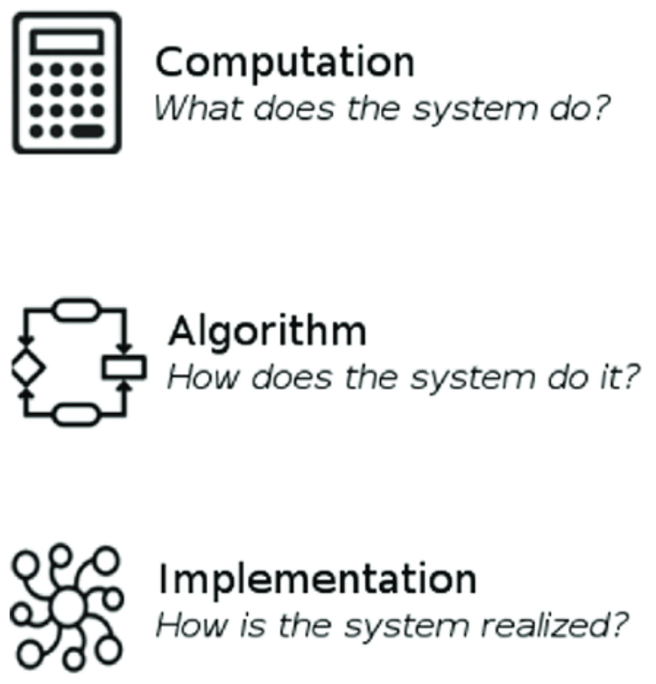
Algorithms for Memory and Simulation
Recap & Overview
Last Time:
Why simulation evolved.
Today:
How it works.
From prediction → generation → causation: a hierarchy of modeling power.
Notes:
In our last lecture, we followed the evolutionary story of how mammals developed the ability to imagine before acting—to simulate futures instead of learning only by doing.
That gave them a profound functional advantage, but it also raises a deeper question: how does a brain—or any system—actually do that?
What kind of information processing makes imagination possible?
Today we move from why simulation evolved to how it works—the algorithmic level in Marr’s framework.
At this level, we don’t yet talk about neurons or anatomy.
We ask: what representations, computations, and rules of updating could allow an animal,
or a machine, to construct an internal model of the world and use it to predict?
As we’ll see, not all “world models” are equal.
There’s a spectrum of modeling power:
At the most basic level, a system can predict—it learns statistical regularities between inputs and outcomes.
At a more advanced level, it can generate—simulate new, unobserved states and test possibilities internally.
And at the highest level, it can reason causally—understand how interventions change outcomes and why things happen.
Most animals, and even much of human cognition, operate solidly in the predictive and generative range.
Only in rare circumstances—like scientific reasoning or deliberate hypothesis testing—do we reach true causal modeling.
This lecture is about tracing that gradient of representational power:
how prediction becomes imagination, and why imagination stops short of full causal understanding.

Slide 3
Algorithms for Memory and Simulation
Prediction
Generation
Causation
A Hierarchy of Models
Prediction: What usually follows.
Generation: What could follow.
Causation: What makes it follow.
Notes:
We can think of intelligence as a hierarchy of modeling power.
At the simplest level, a predictive model learns correlations—when A happens, B tends to follow.
This is enough for most perception and reinforcement learning.
A generative model goes further—it can imagine new or missing data, filling in gaps or running “what if” scenarios.
This is the foundation of simulation and planning.
A causal model is different again.
It represents why things happen—how changing one factor would change another.
That’s the level of explanation and intervention.
Most animal cognition, and much of our own, operates in the first two levels.
The third—causal modeling—is rare, slow, and often depends on language and culture.

Slide 4
Algorithms for Memory and Simulation
Causation
Association
Simulation
From Learning by Association to Learning by Inference
Associative learning links events.
Inference explains events.
What is the relationship of generative models to association-based and causal-based knowledge?
Causation
Association
Simulation
Notes:
For most of evolution, learning meant forming associations: linking one event to another.
A sound predicts food, or a movement predicts danger.
This is the power of correlation—learning what usually follows what.
But inference takes a step further.
It tries to explain why things co-occur—what hidden factors might generate the pattern.
When a system can infer the causes behind its inputs, it’s no longer just reacting—it’s modeling.
What’s the relationship between simulation, association, and inference?
What is the causal direction of that relationship?
Do you need a causal model of the world to be able to generate a simulation of the world?
Not really. You can have a simulation that is still fundamentally correlation-based.
It will allow you to generate simulated events.
But it will also be wrong sometimes.

Slide 5
hot
snow
warm
winter
ice
wet
frigid
chilly
heat
weather
freeze
air
shiver
Artic
frost
Enter your answer from Monday. When you’re done, raise your hand.
Reading Check 9-2
Password: imagine
snow
cold
shoe
Memorize the list of words that will appear on the right.
In 30 seconds, I am going to ask to you remember as many as you can. Type
them into the reading check for today’s credit.

Slide 6
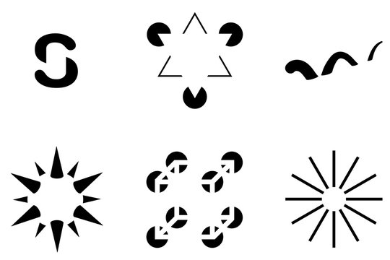
Algorithms for Memory and Simulation
Helmholtz and “Perception as Inference”
We never see the world directly.
We infer it from incomplete, noisy data.
Perception is the brain’s best guess.
Notes:
Helmholtz, in the 1800s, proposed that perception isn’t direct—it’s an act of inference.
Our sensory input is partial and noisy.
What we see, hear, and feel are the brain’s best hypotheses about the world, given that limited data.
He called this unconscious inference.
When we perceive, we’re not passively recording reality—we’re running an internal model and testing it against what reaches our senses.
That model predicts what should be there, and sensory evidence confirms or corrects it.
The result is perception that feels immediate, but is actually an active, predictive process.
This idea later inspired the view of the brain as a generative model—constantly predicting, comparing, and updating.

Slide 7
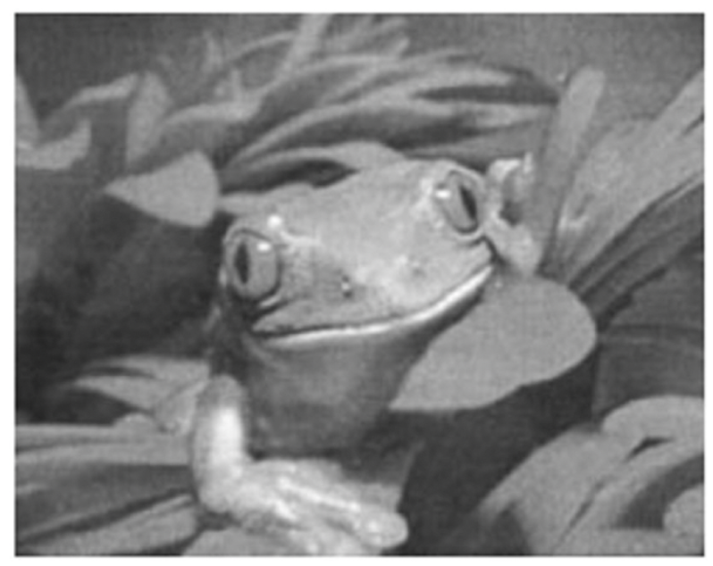
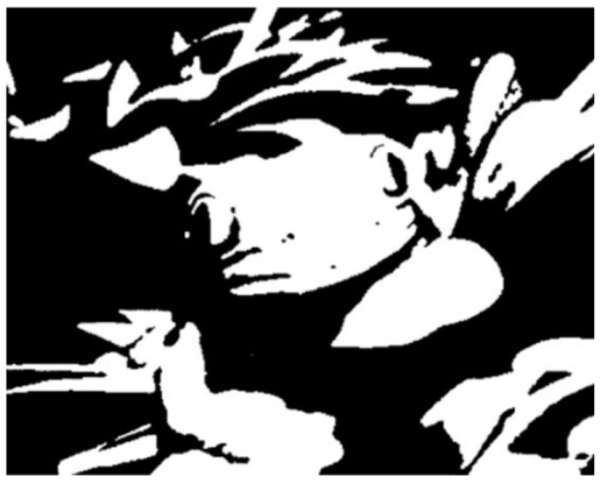
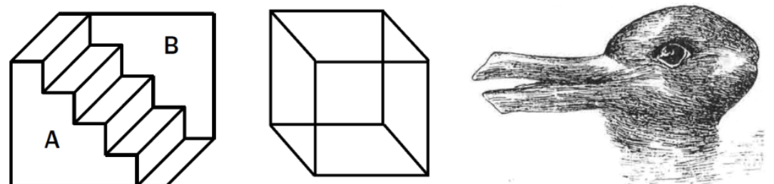
Algorithms for Memory and Simulation
Recognition by Simulation
Perception = prediction tested by sensation.
The brain simulates possible worlds.
The “best-fitting” simulation becomes reality.
Notes:
Every moment, your brain is generating possible explanations for what it might see, hear, or feel.
Sensory input doesn’t build perception from scratch—it selects among the brain’s simulated hypotheses.
This is what it means to recognize by simulation.
The brain internally predicts what the world should look or sound like,
compares that simulation to the actual input, and keeps whichever version minimizes the error.
In effect, perception is the brain’s ongoing experiment: a hypothesis constantly tested against data.
That’s why you can experience illusions, why ambiguous figures flip,
and why you sometimes “hear” your name in noise.
Your brain isn’t being fooled—it’s doing its job: predicting first, sensing second.

Slide 8
Algorithms for Memory and Simulation
Perceptual Clues
Fill in: The brain invents missing detail.
One-at-a-time: Perception is serial, not simultaneous.
Can’t unsee: Once the model locks in—you can’t unsee it.
Notes:
Helmholtz’s idea that perception is inference becomes obvious once you start noticing how the brain handles incomplete or ambiguous input.
Our perceptual system doesn’t just receive data—it fills in, interprets, and commits to a single explanation.
First, it fills in missing detail.
When parts of an image are hidden or noisy, your brain hallucinates the rest based on past experience.
Second, perception is serial—we resolve one interpretation at a time.
When an image or sound is ambiguous, we flip back and forth but never hold both versions at once.
The brain commits to a model, tests it, and revises it if new evidence appears.
Finally, perception is sticky—once your brain finds a coherent model, it’s almost impossible to unsee it.
The model becomes self-confirming: sensory data are interpreted through it.
That’s the defining signature of an inferential, generative system.

Slide 9
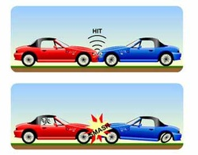
Algorithms for Memory and Simulation
hot
snow
warm
winter
ice
wet
frigid
chilly
heat
weather
freeze
air
shiver
Artic
frost
Memory as Reconstruction
Memory isn’t playback—it’s reconstruction.
Each recall is a new simulation.
Remembering and imagining use the same machinery.
snow
cold
shoe
Notes:
The same predictive process that guides perception also shapes how we remember.
Memory is not a literal recording—it’s a reconstruction, generated anew each time we recall an event.
When you remember something, your brain doesn’t “retrieve” a stored copy; it recreates the experience from fragments and expectations.
That’s why memories can be updated, distorted, or blended over time—each act of recall is a small act of imagination.
Neuroscience confirms this: brain imaging shows that remembering and imagining activate nearly identical networks, especially in the hippocampus and default-mode system.
In other words, to remember is to simulate the past.
This isn’t a flaw—it’s efficient.
A generative memory system can compress information, generalize across experiences, and adapt to new situations.
It trades perfect accuracy for flexibility—the same trade-off that underlies prediction itself.

Slide 10
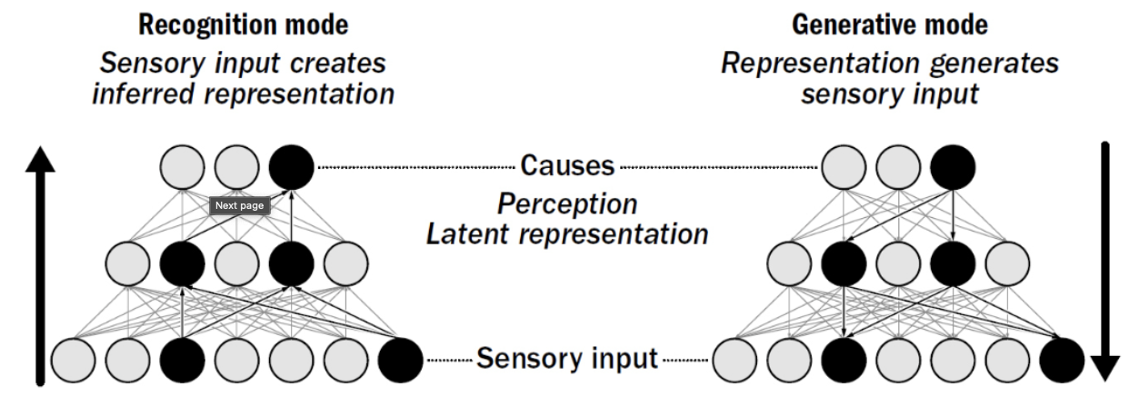
Algorithms for Memory and Simulation
The Helmholtz Machine and Early Generative AI
The same logic powers perception, memory, and learning.
Predict → compare → correct.
Early generative networks made this process explicit.
Notes:
The same predictive loop that drives perception and reconstructive memory also forms the basis for learning itself.
In the 1990s, computer scientists began building algorithms to capture this process explicitly.
Geoff Hinton’s Helmholtz Machine was one of the first.
It learned not by memorizing inputs, but by reconstructing them—predicting what should be there and updating when it was wrong.
The key idea was that a good model can generate the world it represents.
If it can accurately recreate the sensory data, then it must have captured the structure that produced it.
That’s what we mean by a generative model: one that learns by predicting and correcting its own errors.
When mammals began to simulate outcomes before acting, they discovered this same loop: predict, compare, and update.
Modern generative models are simply formalizing what evolution invented millions of years ago.

Slide 11
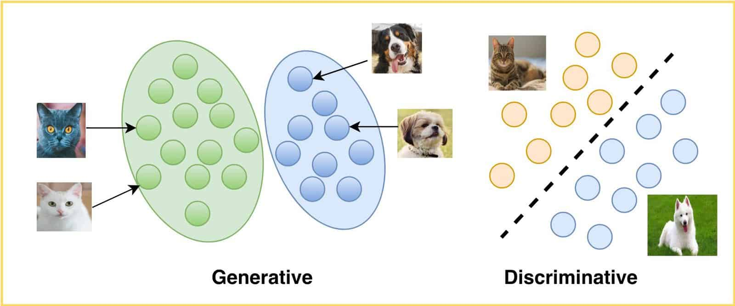
Algorithms for Memory and Simulation
Generative Models Learn Without Labels
No teacher needed.
Prediction itself is the lesson.
Learning happens by reducing surprise.
Notes:
In traditional learning, a system needs a teacher—correct answers or “labels” that tell it when it’s right or wrong.
Generative models don’t.
They learn directly from the structure of the data by trying to predict what comes next.
Each prediction produces an error, and that error becomes the feedback signal.
The model updates itself to make the world less surprising next time.
This is the same principle that drives perceptual inference and memory reconstruction—the brain learns by minimizing prediction error.
That’s why animals, and even newborns, can learn without explicit instruction.
Every sensory encounter is a small experiment: “What do I expect to see, and what actually happens?”
The difference between the two is the lesson.

Slide 12
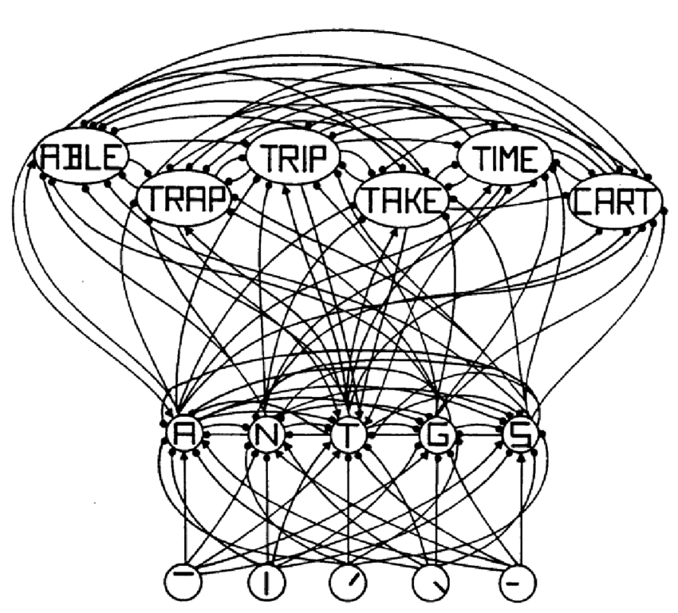
Algorithms for Memory and Simulation
Prediction Error Minimization – The Core Algorithm
Brains and models learn by reducing surprise.
Prediction errors are not mistakes—they’re information.
Every perception is an experiment.
Notes:
At the heart of generative learning is a simple rule:
minimize prediction error.
The brain constantly predicts incoming signals, compares them with reality,
and updates its model to reduce the mismatch.
This is the same principle we saw in perception, memory, and imagination
—prediction is the default, and surprise is the signal that drives change.
Each prediction error tells the system how its model of the world needs to adjust.
That’s how a brain learns patterns it was never explicitly taught.
In this sense, every act of perception is also an experiment.
The brain tests its model against sensory evidence, refines it,
and becomes just a little less surprised next time.
Learning is simply the process of becoming better at predicting the world.

Slide 13
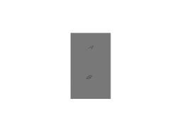
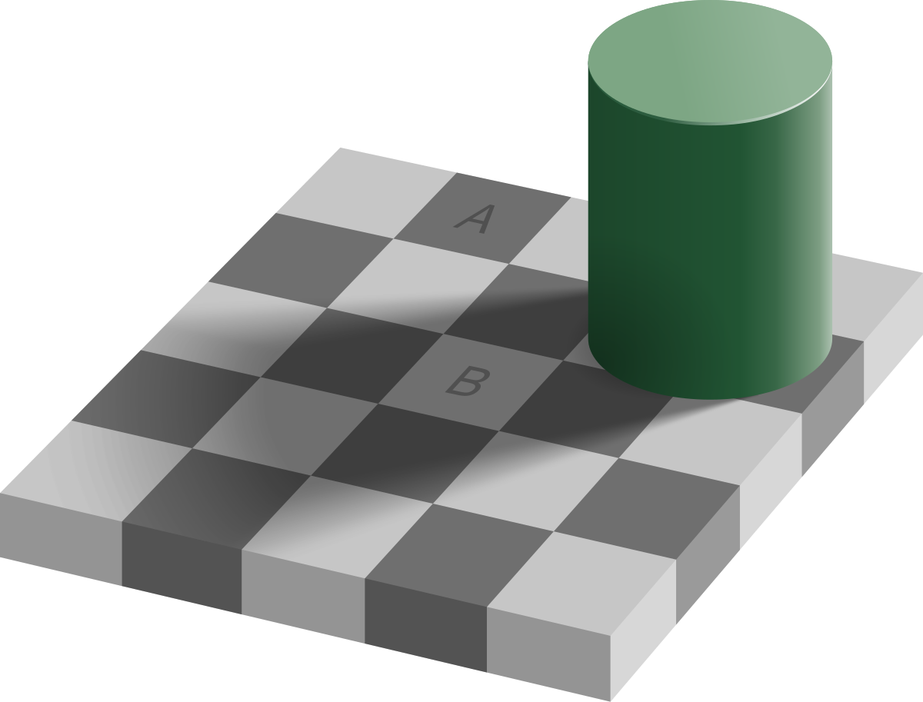
Algorithms for Memory and Simulation
Perception as Constrained Hallucination
Your brain is always hallucinating.
Sensation just keeps it in check.
Prediction creates perception.
Notes:
If the brain is always predicting, then perception itself is really a kind of hallucination—one that just happens to be anchored by sensory data.
At every moment, the brain is generating a detailed internal simulation of what it expects to experience.
Incoming sensory signals don’t build that world—they correct it.
Most of the time, the model and the input line up perfectly, and it feels like you’re simply seeing reality.
But illusions and dreams reveal what’s happening underneath: when the constraints loosen, the simulation runs free.
This is what neuroscientist Anil Seth calls “controlled hallucination.”
Your perceptual world is your brain’s best guess, continuously stabilized by sensory evidence.
You don’t see the world as it is—you see the world as your brain expects it to be.

Slide 14
Algorithms for Memory and Simulation
Prediction
Prediction and Input in Balance
Perception = prediction + evidence.
Too much prediction → hallucination.
Too much input → noise and confusion.
The mind needs both to stay grounded.
Perception
Input
Notes:
The brain’s predictive system depends on a constant dialogue between
top-down predictions and bottom-up sensory input.
Prediction gives perception structure and continuity.
Sensory input anchors those predictions to reality.
Perception, in its healthy form, is the meeting point of the two
—a world that’s both coherent and real.
But when the balance tips too far in either direction, perception starts to unravel.
Too Much Prediction – Hallucination and Dream
When predictive activity overwhelms sensory evidence, the brain starts to fill in too much.
The model becomes overconfident—imposing its expectations instead of testing them.
We begin to perceive what we expect rather than what’s there.
In everyday life, this can produce illusions and false recognitions
—like seeing faces in clouds or hearing your phone buzz when it didn’t.
In extreme cases, as in psychosis, internal models dominate so completely
that perception becomes self-generated.
And in dreaming, when the sensory stream shuts down almost entirely, the model runs free
—creating a coherent, vivid world from its own predictive machinery.
Dreaming is the extreme case of prediction unconstrained by input.
Too Much Input – Noise and Fragmentation
The opposite problem is too little prediction.
When the brain can’t impose expectations on the sensory stream, experience loses coherence.
This can happen in sensory overload, hallucinogenic states, or sleep deprivation.
People describe these experiences as overwhelming:
too much raw sensation, no filter, no context.
The world becomes fragmented—bright, loud, but meaningless.
In neuropsychiatric conditions like autism or schizophrenia,
researchers suspect variations of this imbalance:
predictive signals too weak to suppress noise,
or too strong to update with evidence.
In both cases, the mind struggles to stay grounded in shared reality.
Even prolonged wakefulness can destabilize the loop.
The longer a brain stays awake, the more its predictive model drifts.
Without the recalibration of sleep and dreaming,
prediction errors accumulate until the system
begins to generate its own corrections—hallucinations.
The Sweet Spot – Balanced Perception
Healthy perception lies between these extremes.
Prediction gives the world shape and meaning; sensation gives it truth and constraint.
When they’re balanced, we experience a world that’s both stable and surprising—real enough to navigate, but flexible enough to learn from.

Slide 15
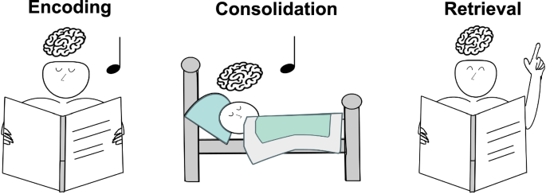
Algorithms for Memory and Simulation
Generative Replay and Memory Integration
Brains learn by replaying imagined experience.
Memory consolidation = internal simulation.
Old and new experiences merge through generative replay.
Notes:
Brains learn by replaying imagined experience.
Memory When we sleep—or even when we rest quietly—the brain doesn’t go idle.
It replays patterns of neural activity from waking experience.
But this replay isn’t literal; it’s generative.
The brain runs simulated versions of past events, recombining and refining them.
This process, called generative replay, serves two purposes.
First, it consolidates what was learned—strengthening the connections that predict important outcomes.
Second, it integrates new information with old, blending them into a more general model of the world.
In the hippocampus, neurons that fired during navigation or problem solving will fire again during sleep, replaying paths and sequences.
But the replay is often distorted—shortened, blended, or even reversed.
That’s the brain simulating possibilities, not just reproducing memory.
This is why sleep improves learning and creativity: it allows the generative model to rehearse and reorganize experience, extracting patterns that weren’t obvious during waking life.
= internal simulation.
Old and new experiences merge through generative replay.

Slide 16
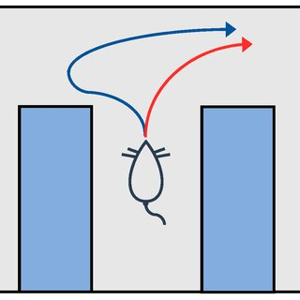
Algorithms for Memory and Simulation
Counterfactual Simulation – Thinking “What If.”
Generative models can imagine alternatives.
Counterfactuals expand learning beyond experience.
“What if” is prediction untethered from history.
Notes:
Once a brain can replay experience, it can also begin to modify it
—to imagine how things might have gone differently.
That’s counterfactual simulation:
the ability to mentally explore alternative versions of the past or future.
In animals, we see this in the hippocampus, where “place cells” fire sequences
representing different possible paths before movement begins.
The brain effectively runs mini-simulations
—What if I turn left instead of right?—then chooses the most promising route.
It’s still the same predictive mechanism, just freed from immediate input.
In humans, counterfactual thinking extends beyond navigation to abstract reasoning:
we imagine alternate choices, social interactions, or outcomes.
But the underlying process remains associative and generative, not necessarily causal.
It predicts how things might unfold based on learned correlations, not why they unfold that way.
This ability to explore possibilities
—to mentally rehearse without acting
—is one of the greatest advantages of a generative brain.
Counterfactuals don’t require causality—they require flexibility.
The brain predicts new combinations of events, using what it already knows.

Slide 17
Algorithms for Memory and Simulation
From Predictive to Generative – But Not Yet Causal - Models
Prediction links events.
Generation simulates possibilities.
Causation explains why—a further leap still.
Model Type | Learns from | Can do | Cannot do
Predictive | Repetition | Expect next event | Imagine new ones
Generative | Simulation | Imagine new outcomes | Explain why they occur
Causal | Intervention | Predict and explain | —
Notes:
By now we’ve seen how prediction can grow into generation.
A system that once just linked events—this follows that
—can now replay, modify, and imagine new combinations.
That’s the power of a generative model: it can simulate what hasn’t happened yet.
But this doesn’t mean it understands why things happen.
Generative models predict outcomes based on correlations
—they’re superb at forecasting but not at explaining.
When a rat imagines turning left instead of right,
it’s predicting a likely outcome, not reasoning about the causal mechanics of the world.
Even most human thought operates this way: fast, associative, and probabilistic.
Causal reasoning—understanding interventions and mechanisms—requires something more:
a structured model that can represent variables and their dependencies.
That’s a distinct and later development, which we’ll turn to next.

Slide 18
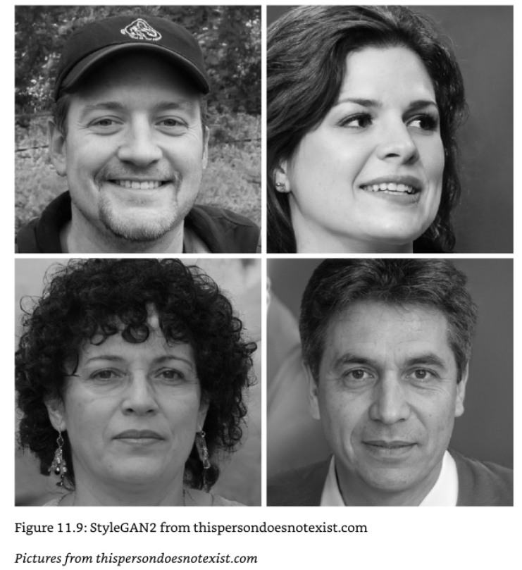



Algorithms for Memory and Simulation
World Models in AI and Brains
Brains and AI both build internal simulations.
A “world model” predicts consequences of actions.
But prediction ≠ understanding.
Notes:
Both biological and artificial systems can build world models
—internal simulations that predict how states of the world change over time.
In animals, this allows flexible behavior and planning.
In AI, it allows agents to rehearse actions virtually before acting in reality.
A world model is any internal structure that can simulate outcomes based on a representation of the environment.
For a rat navigating a maze, that might mean predicting what happens after turning left.
For a modern AI, like a reinforcement-learning agent or an LLM, it might mean predicting the next frame, token, or move.
But prediction alone does not equal understanding.
Many AI systems—and arguably most animal brains
—model what tends to happen without representing why it happens.
They have world models in the generative sense, but not necessarily in the causal one.
The important point is that these systems behave as if they understand the world,
because their generative predictions are so well tuned.
Whether that amounts to understanding is an open question
we’ll revisit when we discuss AI and language models later in the course.

Slide 19
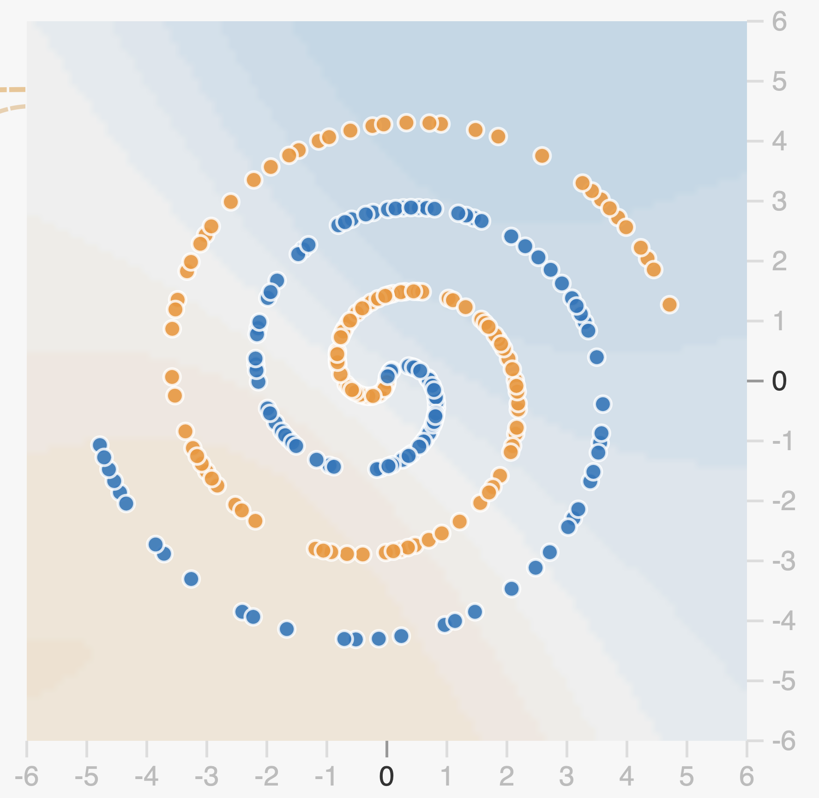
Algorithms for Memory and Simulation
Limits of Generative Models
Generative models predict patterns, not principles.
They imitate structure without knowing cause.
When the world changes, they fail.
Ice Cream Consumed
Hot Weather
?
Number of Drownings
Notes:
Generative models are powerful because they can simulate the world.
But they have a crucial limitation: they capture correlations, not causes.
They learn what tends to happen together, not why it happens that way.
This means that when the world behaves as expected, they perform beautifully.
But when conditions change—when something truly new happens—they falter.
A predictive model can only generalize from what it’s already seen.
It can’t reason through unseen mechanisms or anticipate genuinely novel events.
In animals, this shows up as habitual behavior
—doing what worked before even when it no longer does.
In AI, it shows up when systems confidently generate false but plausible outputs
—what we call hallucinations in language models.
In both cases, the model is extrapolating from correlation,
not understanding underlying structure.
Causal models, in contrast, can adapt
—they can simulate how interventions change outcomes.
That flexibility remains rare in both brains and machines.

Slide 20
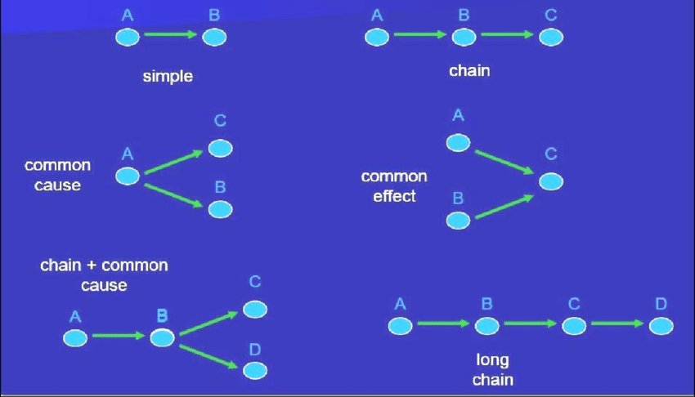
Algorithms for Memory and Simulation
What Makes a Model Causal?
Causal models represent interventions.
They can ask: “What if I change this?”
Understanding = knowing how causes make effects.
Notes:
A causal model doesn’t just predict—it represents how the world’s parts influence one another.
It encodes interventions: what would happen if one variable were changed while others stayed the same.
This is what separates causation from mere correlation.
A generative model can say, “these things usually co-occur.”
A causal model can say, “if I do this, that will change.”
In formal terms, causation requires representing relationships as directed dependencies
—knowing not just that A and B are linked, but that A causes B.
Systems with causal structure can simulate the effects of interventions they’ve never seen before,
because they understand the mechanism that connects cause and effect.
In animals, there’s little clear evidence of this.
Even when they behave flexibly, most learning reflects statistical prediction,
not explicit causal inference.
In humans, causal reasoning appears mainly when we can use language and abstract representation
—tools that make relationships explicit.
In science, we formalize this ability as experimentation itself: changing one thing to see what happens.
Causal reasoning adds a new dimension—it turns the mind from a forecaster into an experimenter.
But that ability is rare in nature, and even in humans, it’s effortful, explicit, and culture-dependent.

Slide 21
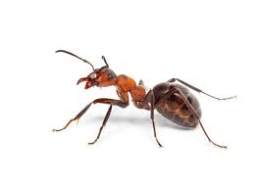


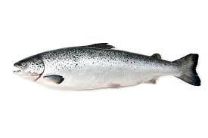
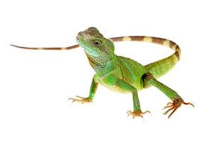
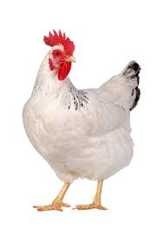
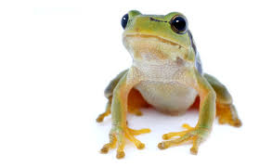


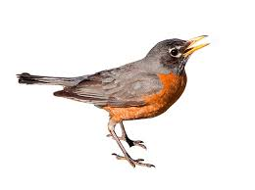


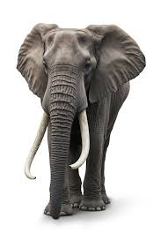

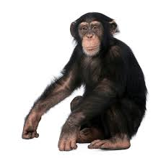

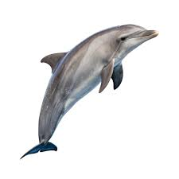

Algorithms for Memory and Simulation
Predicts
Simulates
Simulates
Causality
Evidence for Causal Reasoning Across Species
All vertebrates predict.
All mammals simulate.
Few represent true cause and effect.
Causal reasoning emerges late—and grows with language.
Notes:
Behavioral evidence shows a clear gradient across species.
Many animals learn and plan, but few demonstrate true causal reasoning—the ability to represent interventions and explain outcomes.
Early vertebrates—fish, amphibians, reptiles—learn through association only.
Mammals and birds go further: they can simulate and plan, showing model-based learning and flexible behavior.
But even here, the models appear generative, not causal—they predict what’s likely, not what makes things happen.
Great apes and corvids come closest.
They use tools, plan ahead, and sometimes distinguish cause from correlation, but evidence remains mixed.
Most behaviors still rely on perceptual or statistical regularities.
Only in humans do we see clear signs of variable-based causal reasoning—especially once language and shared explanation enter the picture.
Children don’t reliably infer causes until age four or five, suggesting that causal thought itself depends on developmental and cultural scaffolds.

Slide 22
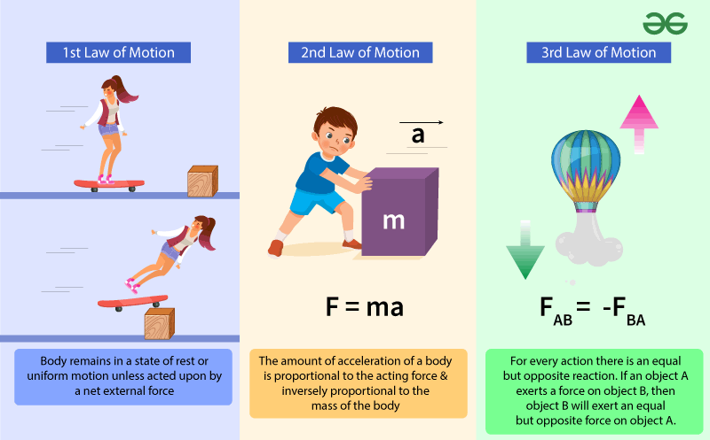
Algorithms for Memory and Simulation
Humans and the Cultural Amplification of Causality
Language makes causes explicit.
Culture preserves and refines them.
Science is collective causal modeling.
Notes:
Once humans developed language and shared learning, causal reasoning could scale.
Language lets us name variables—fire, wind, push, break—and describe relationships between them.
Culture preserves these explanations, turning fleeting insights into traditions of understanding.
And science formalizes it—an organized method for testing causal models by intervention and measurement.
In this sense, causal reasoning didn’t just evolve—it was amplified.
Our brains supply the generative substrate, but our societies supply the tools that make causality explicit.
Through writing, diagrams, mathematics, and shared experimentation, we’ve externalized causal inference into culture.
That’s why even today, individuals without formal education rely mostly on intuitive,
generative reasoning, while science operates as a collective causal mind
—an external extension of the brain’s predictive machinery.

Slide 23
The Evolution of the Cortex
Summary
Prediction → Generation → Causation
Each level adds representational power.
Brains predict.
Minds imagine.
Cultures explain.
Next Time
Simulation in the brain and the structure of the neocortex
Notes:
We’ve traced a hierarchy of modeling power—from simple prediction, to generative simulation, to causal explanation.
Prediction lets a system learn regularities: when one event follows another.
Generative modeling lets it simulate new possibilities—to imagine what could happen.
Causal reasoning adds something rarer: the ability to represent interventions and understand why events unfold as they do.
Across evolution, most brains stopped at the first two stages.
They became expert simulators—creatures that could predict and plan.
Humans went further, but not alone.
Our ability to reason causally depends on cultural scaffolding: language, teaching, shared explanation, and science.
So we can think of intelligence as layered:
Brains predict.
Minds imagine.
Cultures explain.
In the next lecture, we’ll move from the algorithmic what to the biological how:
the neural circuits and architectures that make prediction, imagination, and learning physically possible.

